Slide 1

Snake Game
Python-Based Interactive Game
Submitted By: Varshith Reddy
Registration Number: 12301407
Roll Number: 43
Institution: Lovely Professional University

Slide 2
Introduction
Objectives
Scope
Application Tools
Game Design
Flow Chart
Data Flow Diagram
Testing And Validation
Conclusion
References
AGENDA

Slide 3
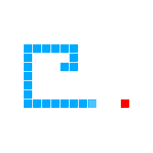
Introduction
The Snake Game is a classic arcade game where the player controls a snake to eat fruits and grow longer. The goal is to avoid running into the walls or the snake's own body. This project showcases my implementation of the Snake Game using Python, utilizing Tkinter for the graphical user interface and Turtle for the game graphics.

Slide 4
Objectives
Enjoy an Interactive Gaming Experience: Play a classic Snake Game with smooth controls and visually appealing graphics.
Select Preferred Difficulty Levels: Choose between Easy, Medium, and Hard modes to customize the gameplay based on individual skill levels
Challenge and Improve Skills: Enhance reflexes and decision-making abilities as the game becomes progressively faster with increasing scores.
Pause and Resume Flexibly: Utilize the pause feature to take breaks during gameplay and resume without losing progress.
Achieve High Scores: Compete to achieve personal best scores and challenge others to beat them, fostering a sense of accomplishment.

Slide 5
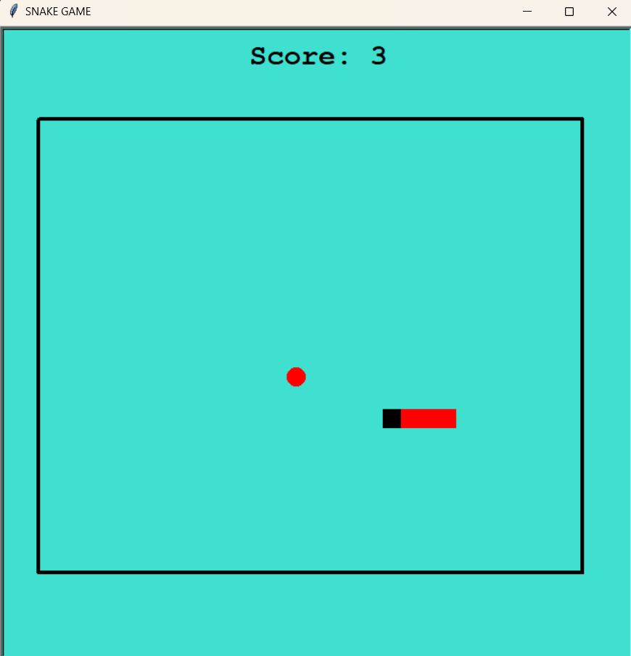
Scope
The application includes:
User Interface: Interactive interface with buttons for starting, pausing, and exiting the game.
Snake Gameplay: Movement controls for the snake and game over conditions.
Difficulty Levels: Options for Easy, Medium, and Hard difficulty, adjusting game speed
Pause/Resume: Allows pausing and resuming the game.
Scoring System: Displays and updates the score during gameplay.

Slide 6
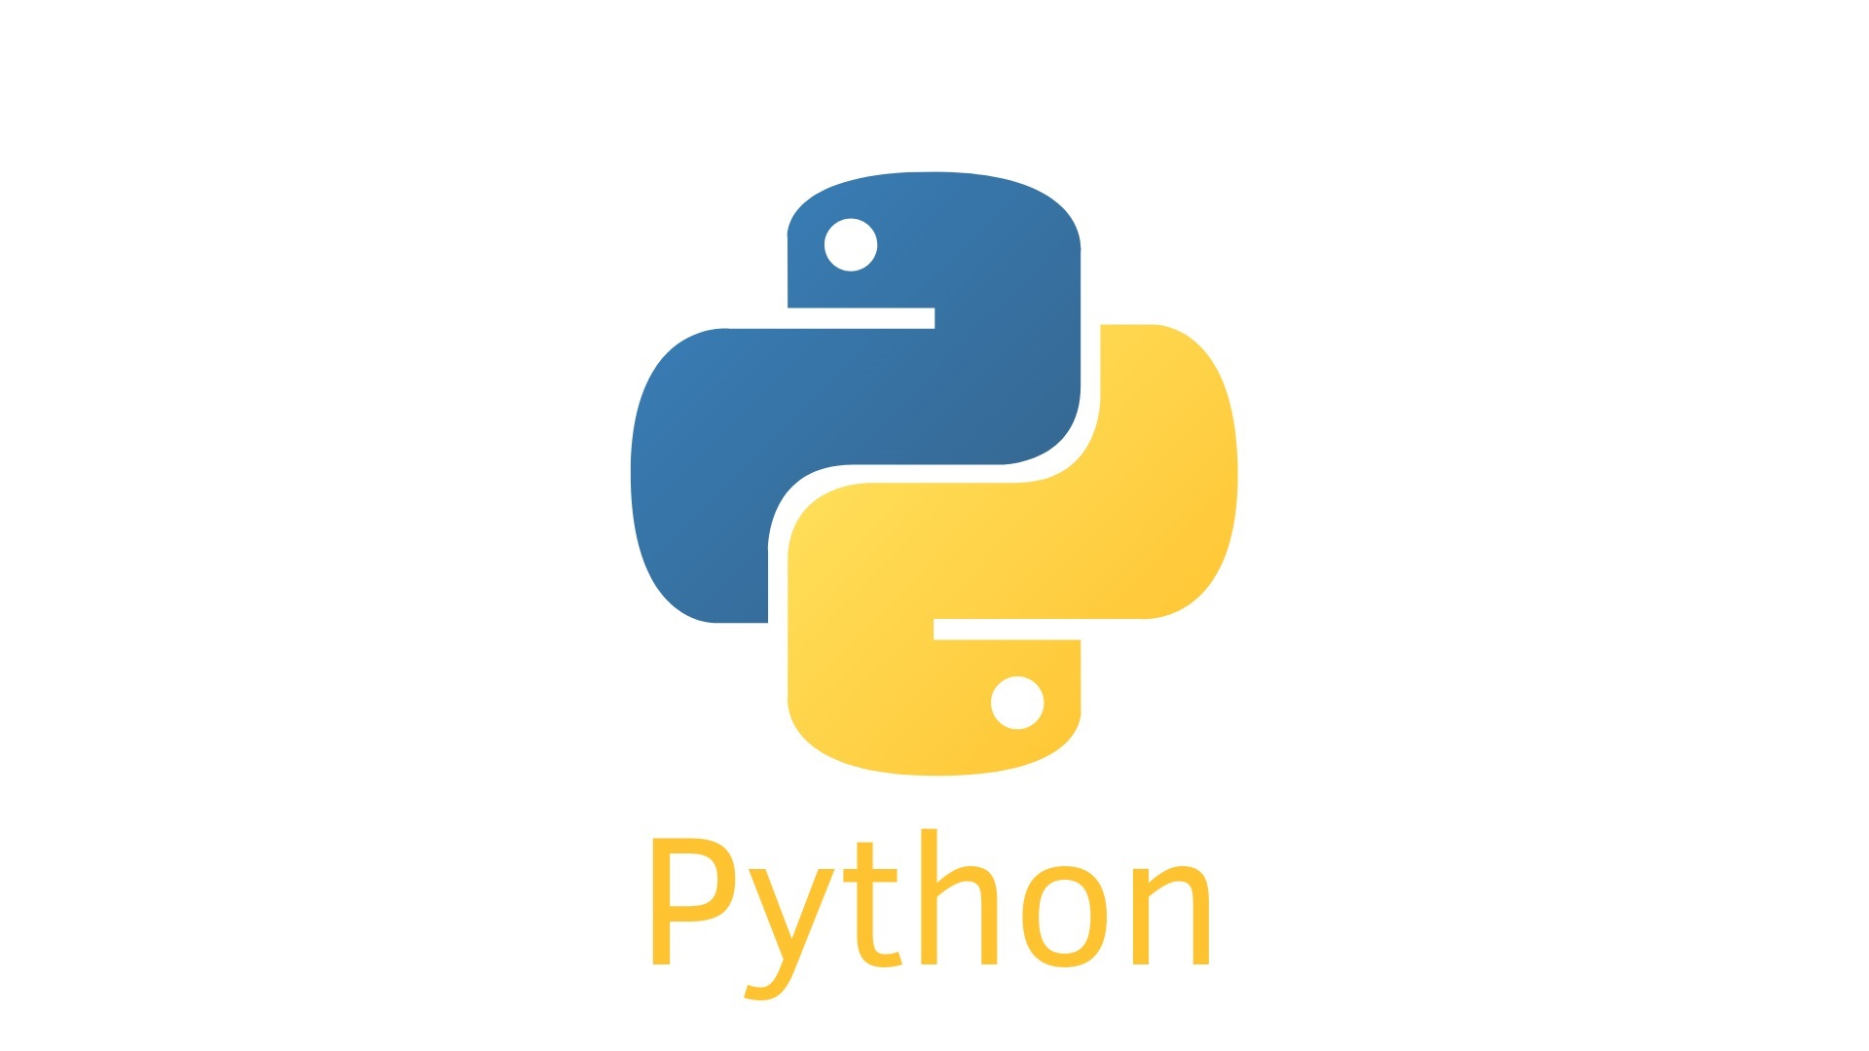
Application Tools
Python: The primary programming language used to develop the game, offering simplicity and flexibility.
Turtle Graphics: Utilized for creating the game’s graphical elements, including the snake, food, and game borders.
Tkinter: A Python library for building the graphical user interface (GUI), allowing user interaction through buttons and menus.
Random Module: Used to generate random positions for the fruit within the game area
Time Module: Manages game delays and the pause functionality to control the speed and flow of the game.
This Photo by Unknown Author is licensed under CC BY-NC-ND

Slide 7

Game Design
Game Window Setup
Dimensions: 700x700 pixels
Background Color: Light blue to keep it visually appealing and calm.
Snake and Fruit Elements
Snake: Black square shapes starting at (0, 0).
Fruit: Red circle appearing randomly.
Growth: Snake grows with each fruit eaten..
Score Display
Displayed at the top center of the game window.
Increments each time the snake eats a fruit.
Game Border
600x500 pixels.
Crossing the border ends the game
Difficulty Levels
Easy, Medium, Hard.
Selectable from the main menu.
Controls
Arrow Keys: Move snake.
Space Bar: Pause and resume.
Pause Functionality
A "Paused" message appears below the score when the game is paused.
The game stops until the player presses the space bar again to resume.
Collision Detection
Fruit Collision: Eat fruit, grow, and new fruit appears.
Border Collision: Game over if touching border.
Self-Collision: Game over if colliding with body.

Slide 8
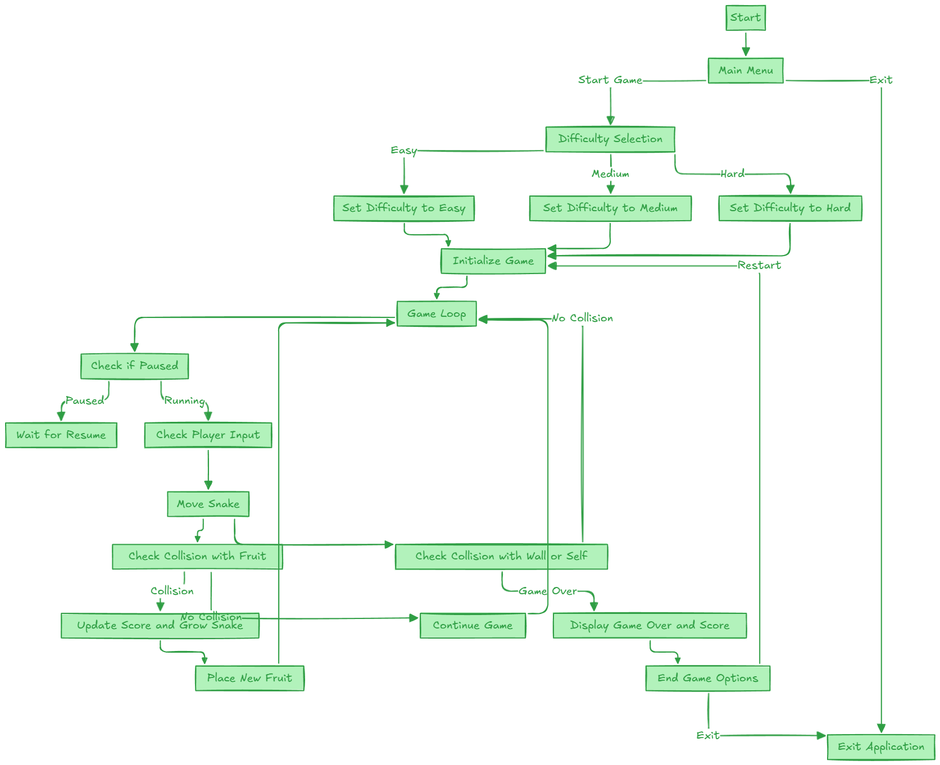
FLOWCHART

Slide 9
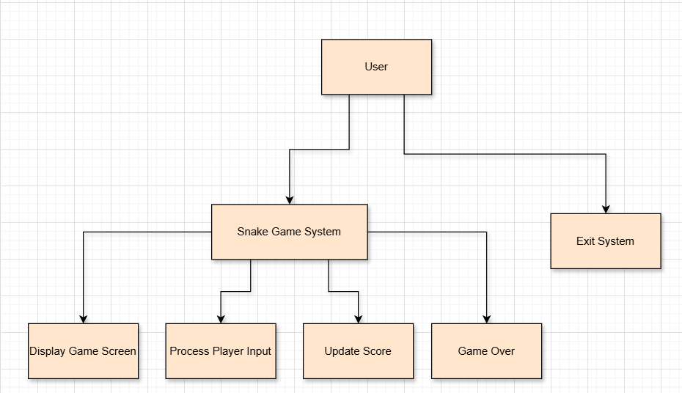
Level 0 DFD

Slide 10
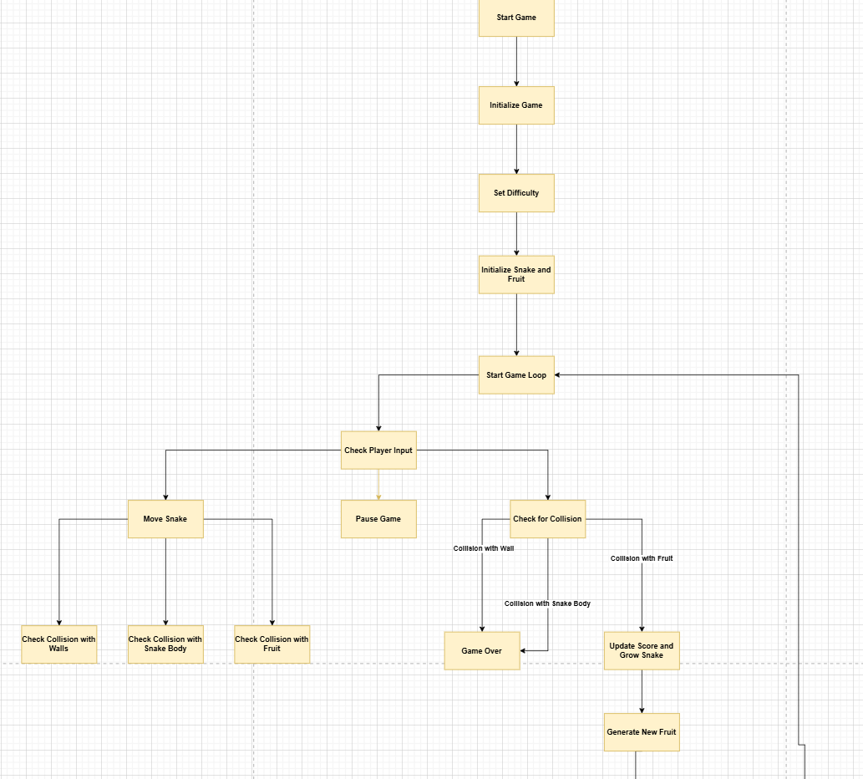
Level 1 DFD

Slide 11
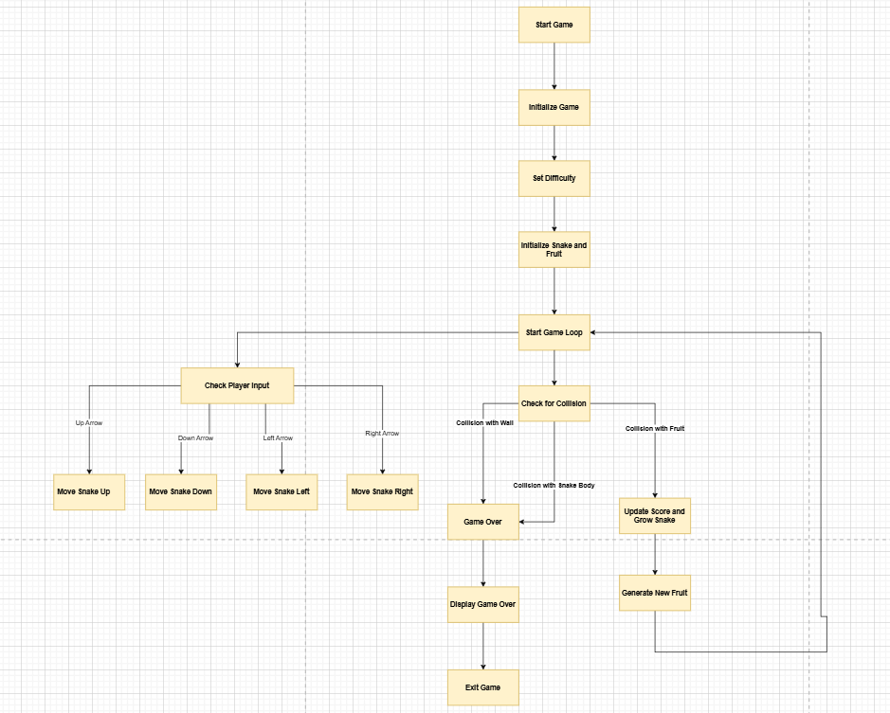
Level 2 DFD

Slide 12
Testing & Validation
Unit testing
Integration Testing
System Testing
Manual Testing
Performace Testing
Verified individual components like snake movement, fruit spawning, and score updates to ensure each part functions correctly
Key Areas Tested:
Movement Functions(up,down,left,right)
Fruit Collision
Score Display
Tested how well the game’s modules work together, ensuring smooth integration of movement, scoring, and pause/resume features
Key Areas Tested:
Control System Integration
Snake and Fruit Interaction
Score and Game Over Handling
Conducted end-to-end testing, playing through the game to ensure all components work seamlessly, including input validation and boundary checks.
Key Areas Tested:
End-to-End Gameplay
Pause and Resume
Boundary and Collision Handling
Testers played the game, checking for usability, error handling, and overall game mechanics to identify bugs and improve gameplay
Key Areas Tested:
Gameplay Experience
Pause/Resume Verification
Score Accuracy
Assessed the game’s performance under different loads, including frame rate consistency and memory usage, ensuring smooth gameplay even with multiple obstacles or snake segments.
Key Areas Tested:
Frame Rate Stability
Game Load and Lag

Slide 13

Conclusion
Achievements:
Dynamic Gameplay: The game adapts to different difficulty levels (Easy, Medium, Hard), providing a more engaging experience based on the player’s preferences.
Real-time Scoring: The system tracks and displays the player's score, creating an interactive gaming experience.
User-Friendly Interface: A graphical user interface (GUI) was designed using Tkinter for easy navigation and a smooth gameplay experience.
Game Functionality: Key functionalities like pause/resume, snake movement, fruit spawning, and game over screen were effectively implemented using Turtle graphics.
Future Enhancements:
Sound Effects
Multiplayer Mode
Leaderboard Integration
AI Opponents

Slide 14
Reference
Python Documentation:
Python's official documentation for understanding language features:
https://docs.python.org/3/
Turtle Graphics in Python:
The turtle module is used to create the visual components of the game:
https://docs.python.org/3/library/turtle.html
3. GeeksforGeeks - Snake Game in Python:
A tutorial that walks through building the Snake Game using Python:
https://www.geeksforgeeks.org/python-snake-game/
4. YouTube - Python Snake Game Tutorial:
A video series explaining step-by-step how to build a Snake Game:
https://www.youtube.com/watch?v=R9ON_vYO9AE
5. Project GitHub Repository:
k23hc64/Python-End-Term-Project: Snake Game using python

Slide 15

Thank You!
Created and Presented by Varshith Reddy

